Slide 1
GCP Foundation
MODULE 3 :
NETWORKING, LOGGING & MONITORING

Slide 2
Revision History
Version | Date | Author | Reviewed by | Comments
1.0 | 03-March-2025 | preetham.gowda |  | Initial Version

Slide 3
Describe cloud networking products
Configure and use VPC
Understand the concepts of logging
Understand the concepts of monitoring

Slide 4
Module Agenda
1
Network Services
2
VPC
3
Logging
4
Monitoring

Slide 5

NETWORK SERVICES

Slide 6
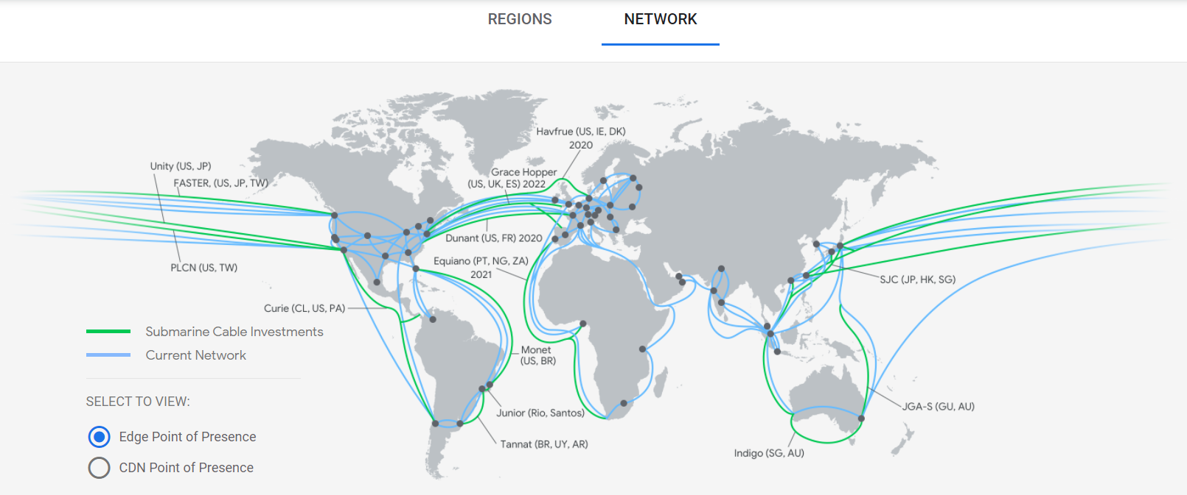
Google Global Network
A global fiber network, connecting you to the world

Slide 7
Cloud Networking Products
Connect
Hybrid connectivity
Connect your infrastructure to Google Cloud
Cloud Interconnect, Cloud VPN, Carrier Peering, and Direct Peering
Virtual Private Cloud (VPC)
Provision, connect, or isolate Google Cloud resources
Routes, firewall, Cloud VPN (Virtual Private Network), and Cloud Router
Cloud DNS
Highly available global DNS network
Service Directory
A service-centric network solution

Slide 8
Cloud Networking Products
Scale
Cloud Load Balancing
Worldwide autoscaling and load balancing
Cloud CDN
Accelerate content delivery

Slide 9
Cloud Networking Products
Secure
Cloud Armor
Infrastructure DDoS defense
Cloud NAT
Google Cloud-managed network address translation
Network Telemetry
Keep services secure with in-depth network telemetry
VPC Service Controls
Security perimeters for API-based services

Slide 10
Cloud Networking Products
Optimize
Network Intelligence Center
Comprehensive network monitoring, verification, and optimization
Network Service Tiers
Optimize your network for performance or cost

Slide 11
Network Service Tiers
Lets you optimize connectivity between systems
Premium Tier
Delivers traffic on Google's premium backbone
Highest performance
For services that need global availability
Unique to Google Cloud
Standard Tier
Delivers traffic on regular ISP networks
Cost optimized
For services hosted entirely within a region
Performance is comparable to other cloud providers

Slide 12
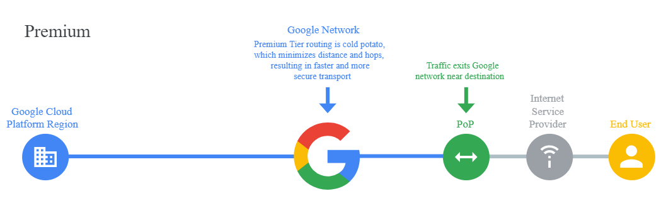
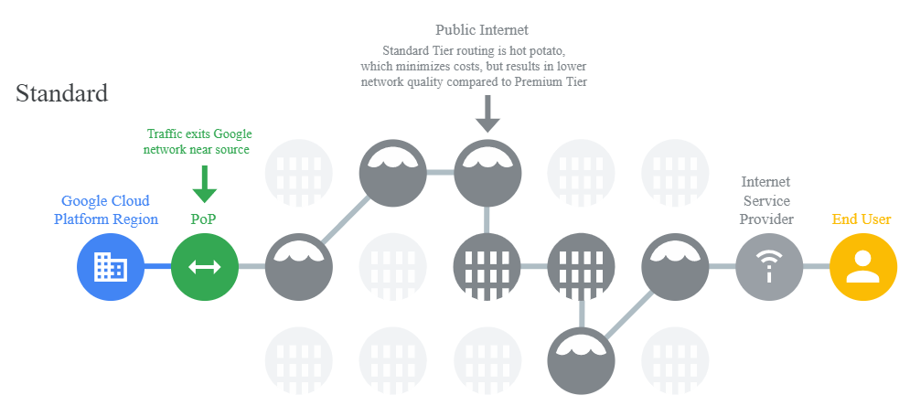
Routing Path

Slide 13
VIRTUAL PRIVATE CLOUD (VPC)

Slide 14
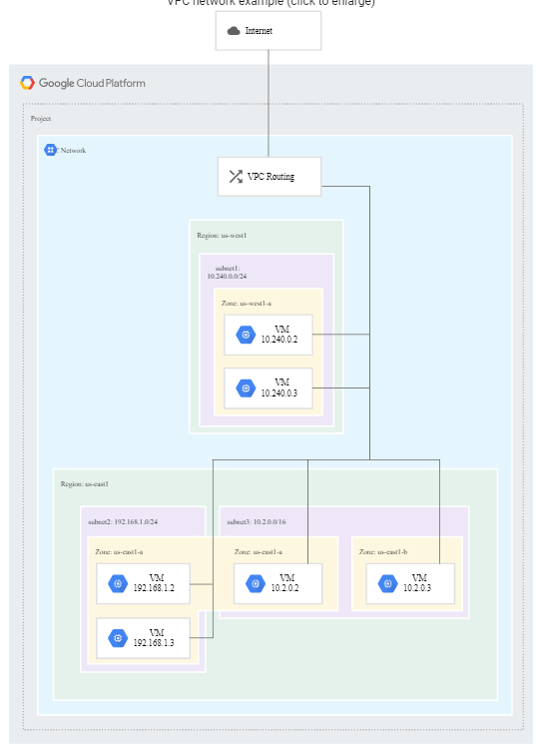
What Is VPC?
Networking for cloud-based resources and services
Google Cloud VPC offers networking functionality to
Compute Engine virtual machine (VM) instances
Google Kubernetes Engine (GKE) containers
App Engine flexible environment
VPC provides networking for your cloud-based services which is global, scalable, and flexible
VPC network is a global resource that consists of a list of regional virtual subnetworks

Slide 15
VPC
Specifications
VPC is not related with any particular region or zone
Subnets are considered to be regional resources
Each subnet provides a range of IP addresses
Traffic within the instances can be controlled with network firewall rules
Resources in the same VPC network can communicate with one another by using internal IP addresses
VPC networks only support IPv4 unicast traffic
It is possible to create an IPv6 address for a global load balancer

Slide 16
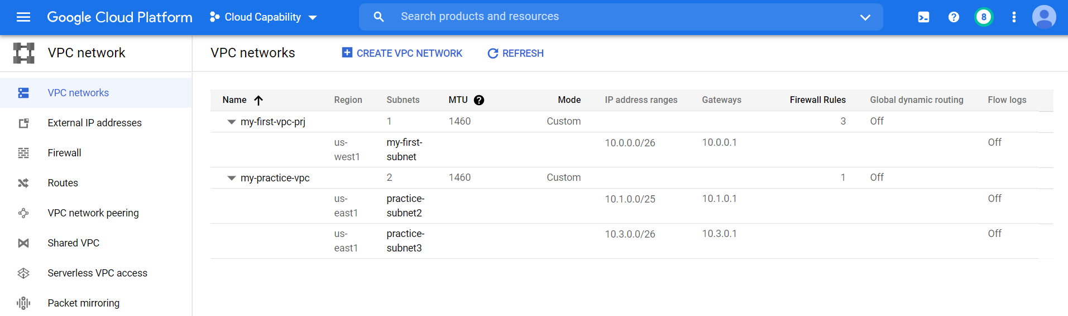
Subnet
IP range partitions of VPC
Subnet is associated with a region
IP ranges (non-overlapping CIDR block) are defined for the subnets
VPC must have at least one subnet
Auto mode and Custom mode VPCs
Notes:
Auto mode VPC networks create subnets in each region
Custom mode VPC gives full control over subnet creation
You can switch a VPC network from auto mode to custom mode (One way)

Slide 17
LOGGING

Slide 18
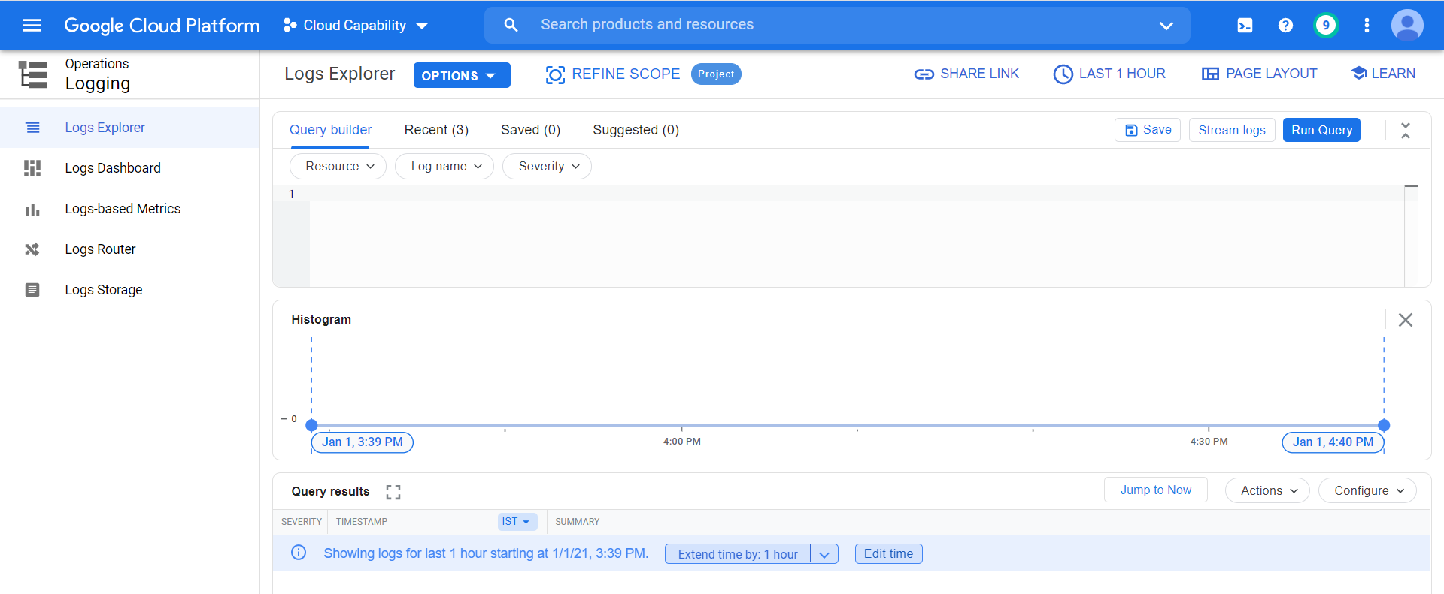
Logging
Cloud Logging lets you to
Store, search, analyze, monitor, and alert on logging data and events
From Google Cloud services

Slide 19
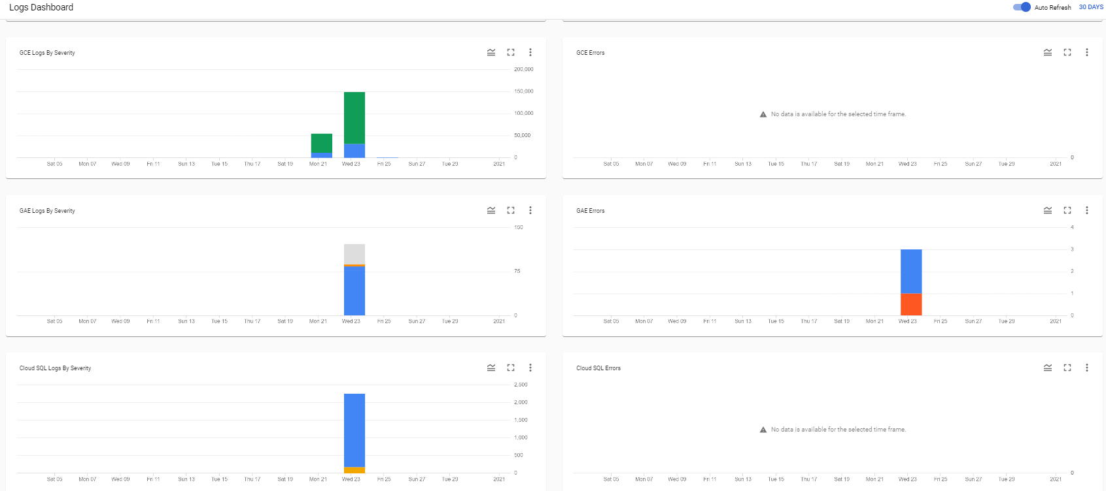
Logs Dashboard
Provides quick view based on various parameters

Slide 20
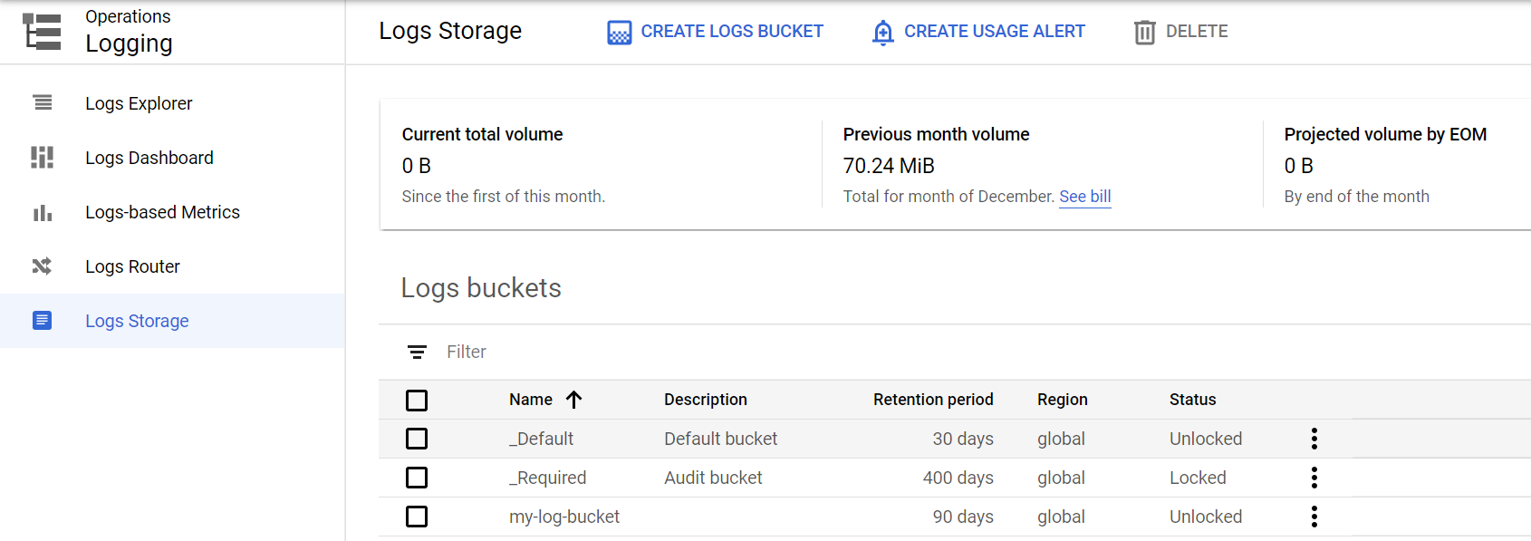
Log Retention
Stored in Log buckets
Application / Service Log: 30 days
Audit log: 400 days
Custom storage

Slide 21
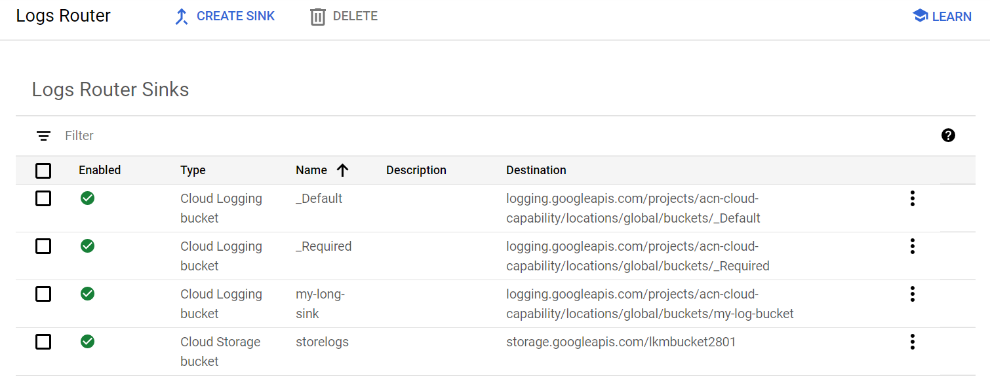
Log Sink
Log Router
Sink logs to custom bucket
Retain for customized period

Slide 22
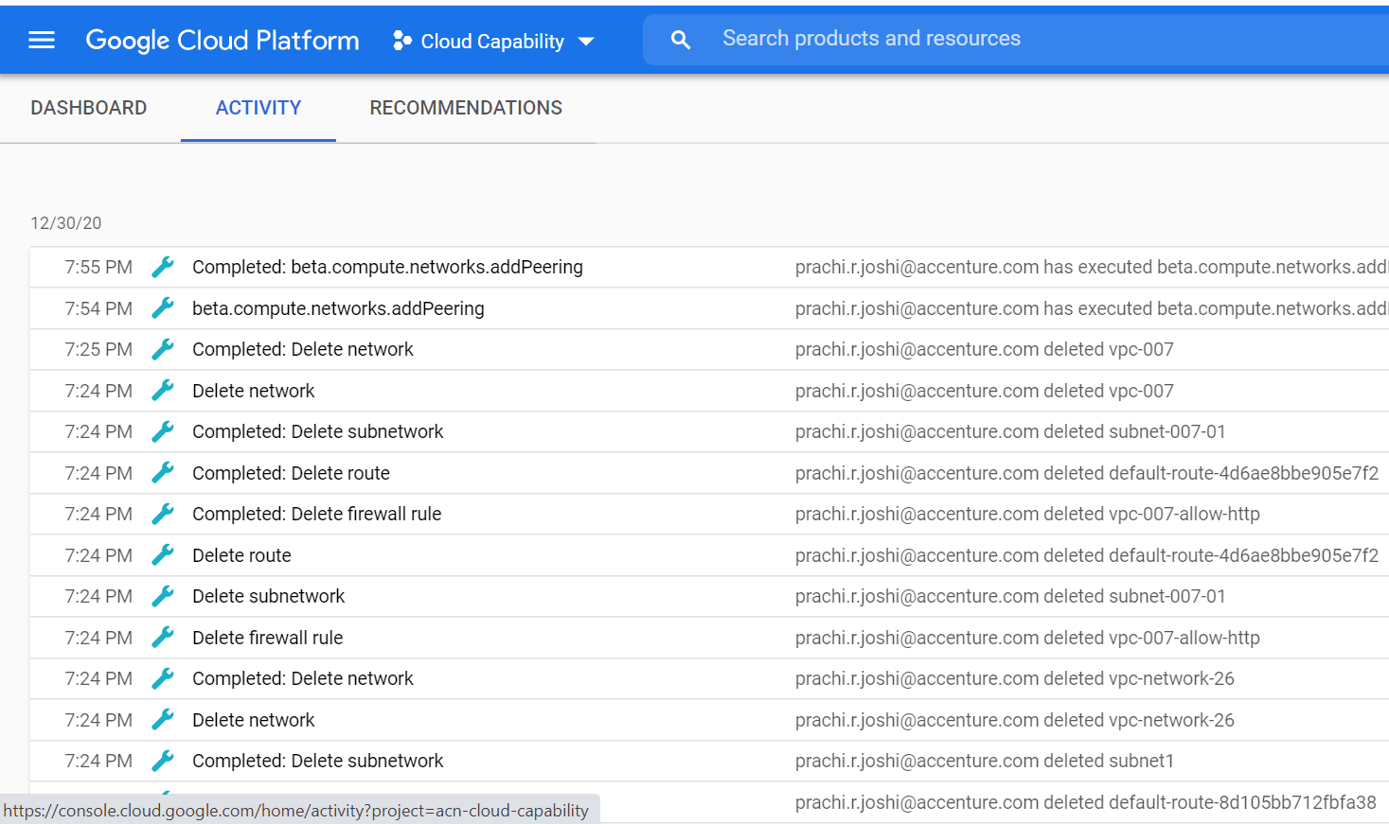
Audit Log
Audit log gives detailed information about Who did what, where, and when
Admin Activity audit logs
Data Access audit logs
System Event audit logs
Policy Denied audit logs

Slide 23
MONITORING

Slide 24
Cloud Monitoring
Who did what, where, and when
It collects metrics, events, and metadata
From Google Cloud, hosted uptime probes, and application instrumentation
It also collects logging data from over 150 common application components

Slide 25
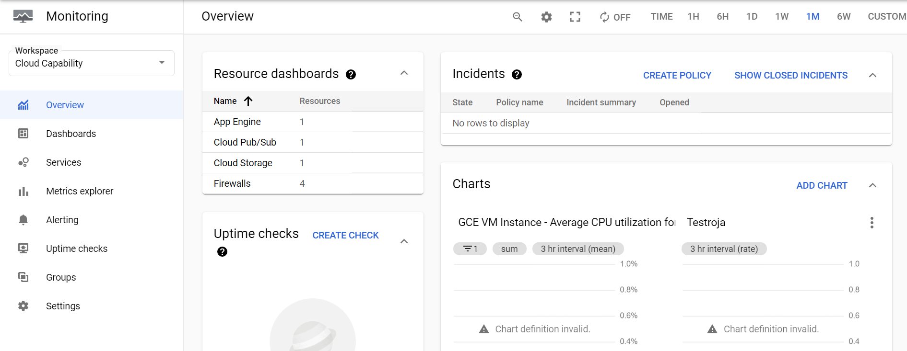
Cloud Monitoring

Slide 26
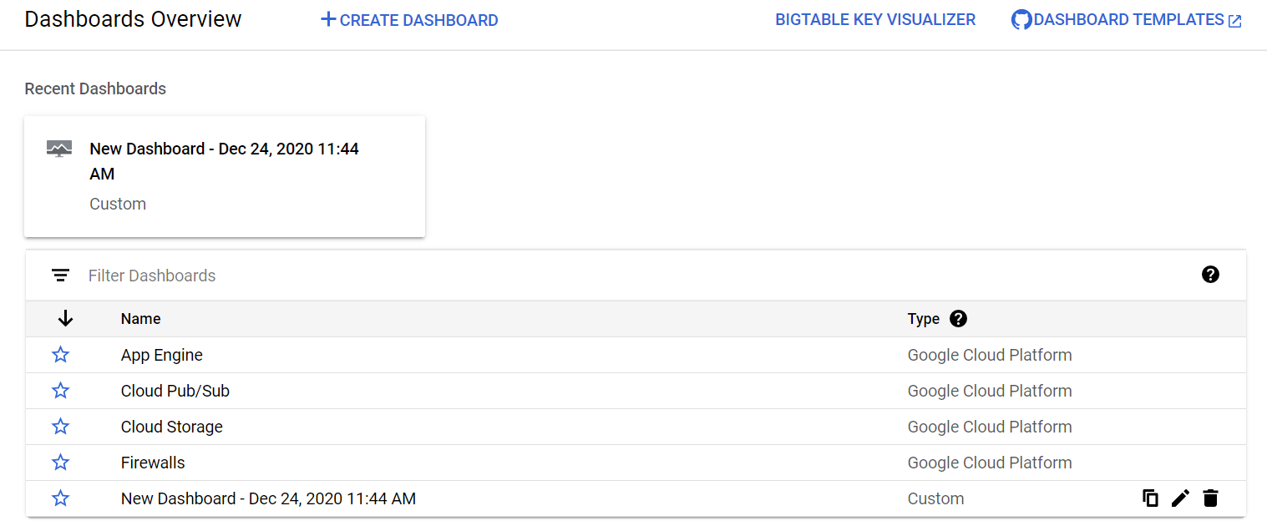
Monitoring Dashboards
Pre-defined & custom dashboards

Slide 27
Describe cloud networking products
Configure and use VPC
Understand the concepts of logging
Understand the concepts of monitoring

Slide 28
THANK YOU

